Slide 1
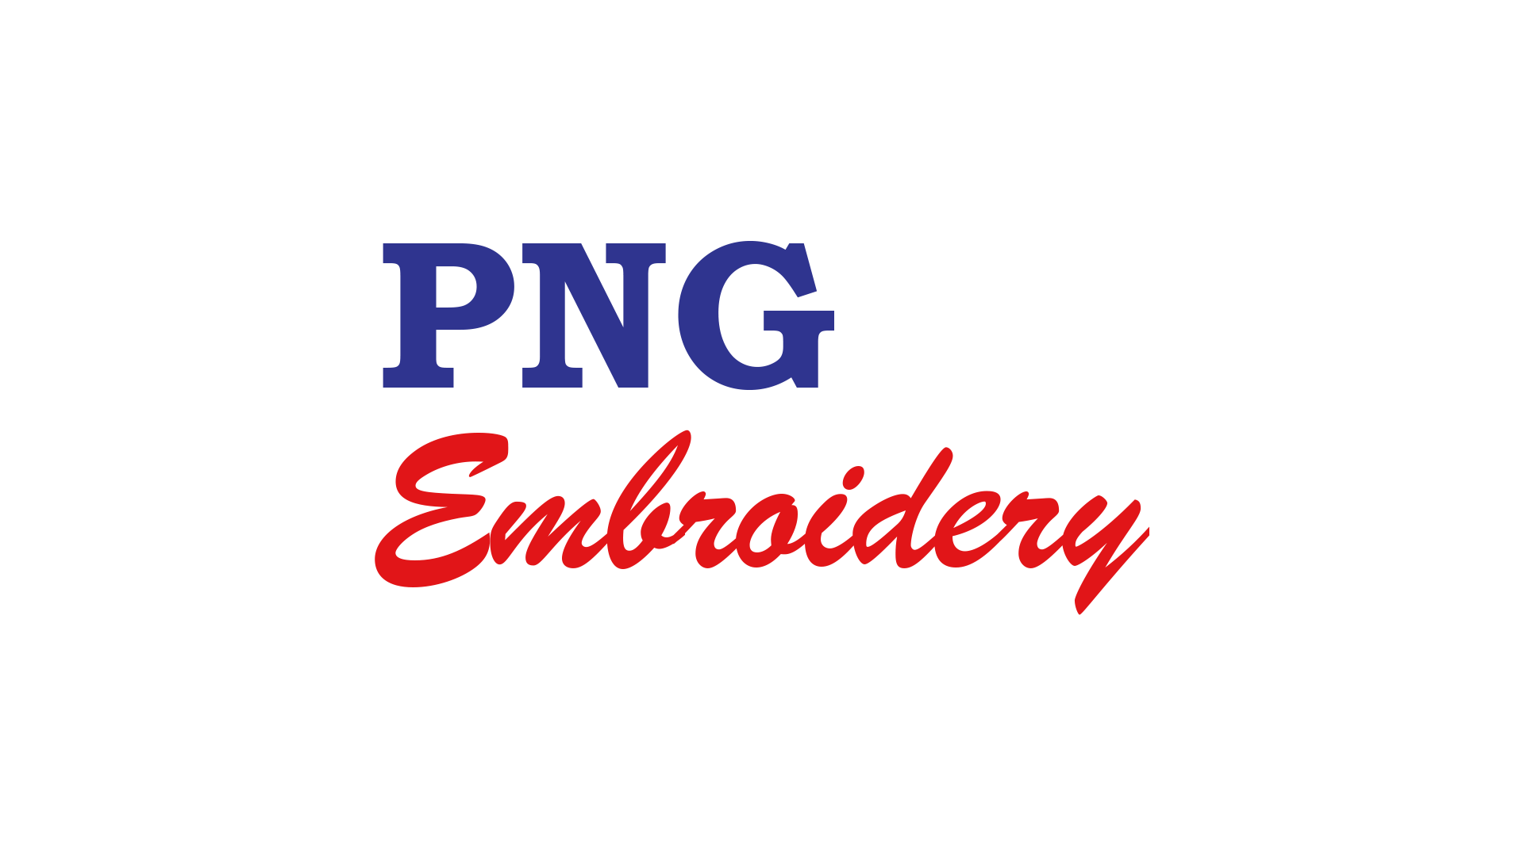
PNG EMBROIDERY
Industry's Most Favoured Workwear

Slide 2
Who are we?
PNG Embroidery is a manufacturer, wholesaler, retailer and distributor of textile products and Embroidery Products.
The main products include:
Corporate / Company uniforms
Heavy-duty Protective Clothing,
industrial safety wears
Office Uniforms
Promotional items,
T-Shirts, Caps, Mugs, Lanyard and linen for the hotel & hospitality industry

Slide 3
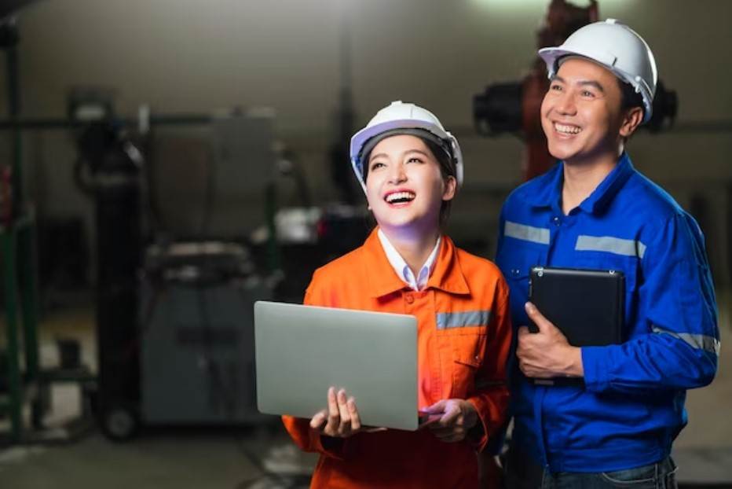
Who are we?
We have become the leading uniforms manufacturer and largest Embroidery company in Papua New Guinea, controlling over 60% of the market with the most advanced Hi-Tech Japanese Embroidery machinery. We operate from its new and larger premises, 451, Allotment 17, Unit 9 Cameron Road, Waigani Drive (Opposit Boroko Motors).

Slide 4
Our expansion
In the latter part of 2006, the company modernized its operations with the new and the latest Embroidery plant & equipment from TAJIMA, Japan.
Additional personnel with relevant technical expertise have been sourced from Sri lanka & Philippines. The personnel are now on site assisting a large number of well-experienced Papua New Guineans, in producing and distributing quality PNG MADE textile products.
The growth of the business and its market share comes from the performance of its brand name and quality, and consistent focus on its consumers.
4

Slide 5
Three picture collage
The company has participated upon invitation by the PNG Government through the Department of Trade and Industry and Melanesian Spearhead Group (MSG) in several overseas trade fairs and exhibitions.
PNG Embroidery Ltd was invited to participate in Trade & Investment Mission in: - South Korea – Japan - Solomon Island - Vanuatu - Fiji.
PNG Embroidery Ltd is a leader in its own right in PNG in the Embroidery technology and textile industry. It has developed and maintains a market and product line which are reliable, possessing competitiveness and quality with reasonable pricing affordable by PNG’s corporate sector.
Industry participation

Slide 6
Our market
The company's main product line includes:
Company & corporate uniforms
Industrial safety wear
Corporate gift & promotional items
Linen to the hotels and tourist resorts
6

Slide 7
Four picture collage
Our major customers include:
(Air Niugini - Prime Minister Department Office - PNG Police Constabulary - C.I.S, Bomana Police College - Office of Higher Education - Hargy Oil Palm - UPNG - PNG AIDS Council - Department of Health - Telikom - Airways Hotel - Holiday Inn - Crown Plaza - many more)
Some other customers are banks, hospitals, schools, security companies, mining and petroleum sectors and other corporate bodies. PNG Embroidery Ltd controls over 60% of the Papua New Guinea textile market and it is still exploring ways and means of increasing this market share and continuing to offer better services to its customers.

Slide 8
OUR PRODUCTS

Slide 9
Five picture collage
ProMan workwear

Slide 10
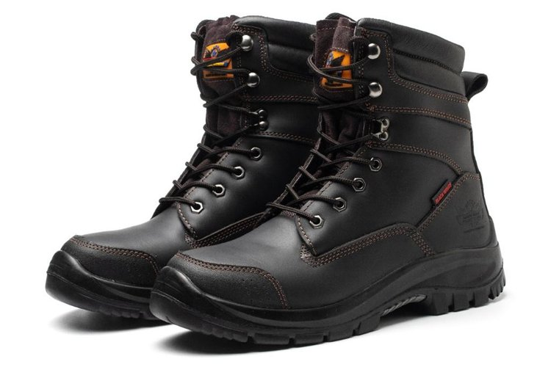
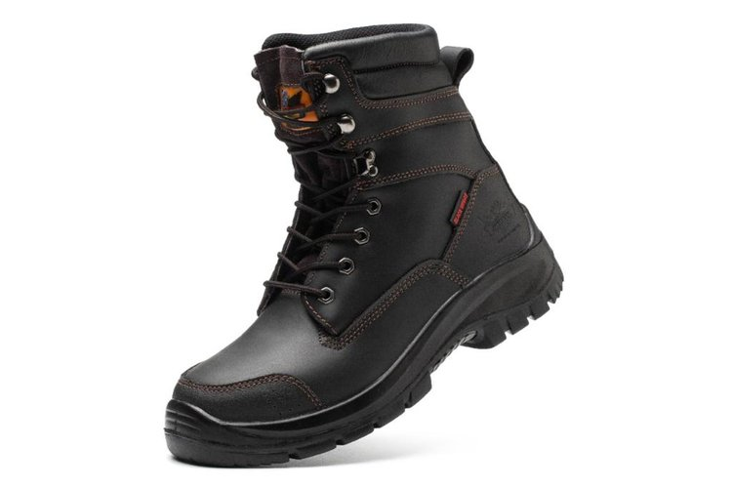
Five picture collage
Blackwings

Slide 11
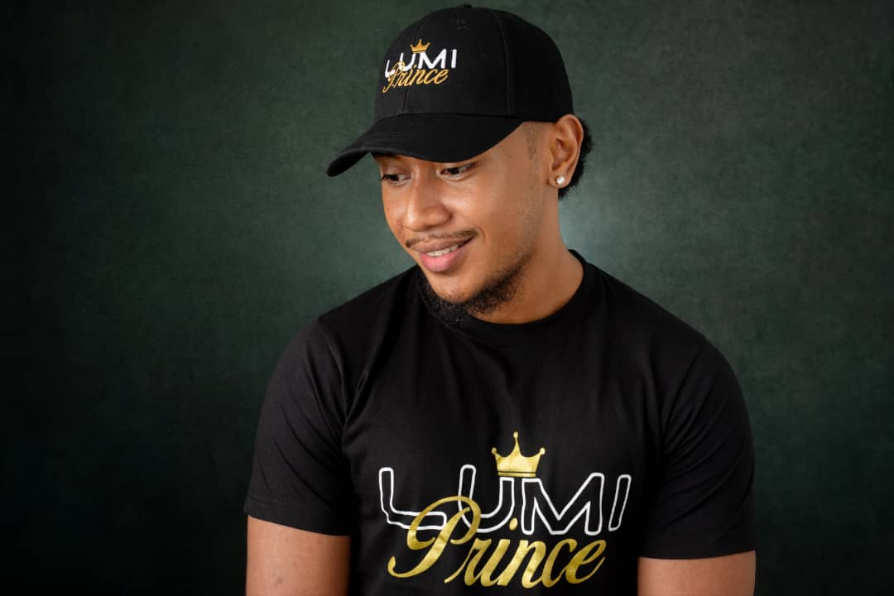
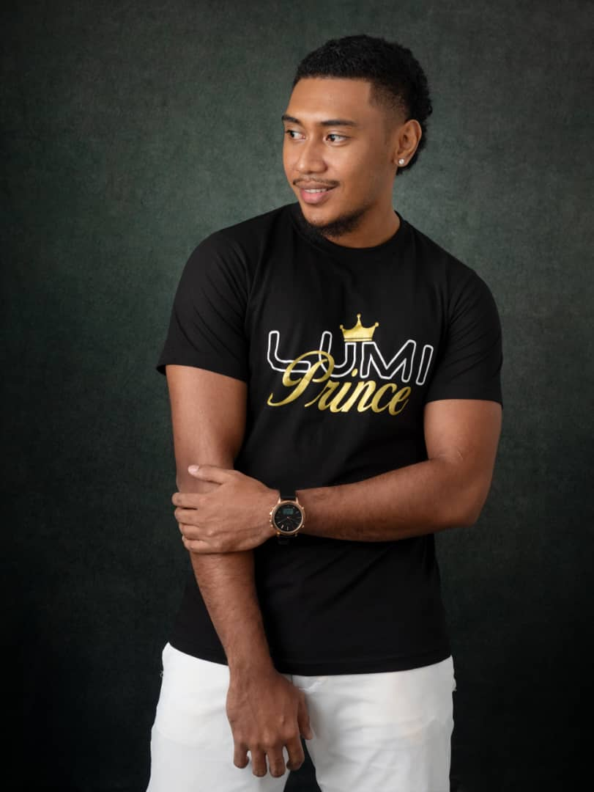
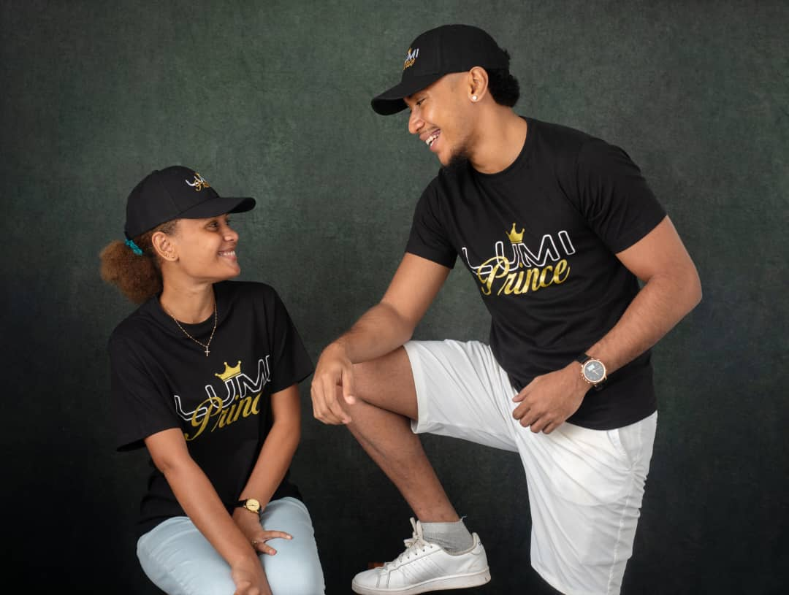
Five picture collage
T-SHIRT

Slide 12
Five picture collage
PROMOTIONAL ITEMS

Slide 13
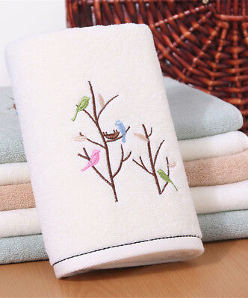
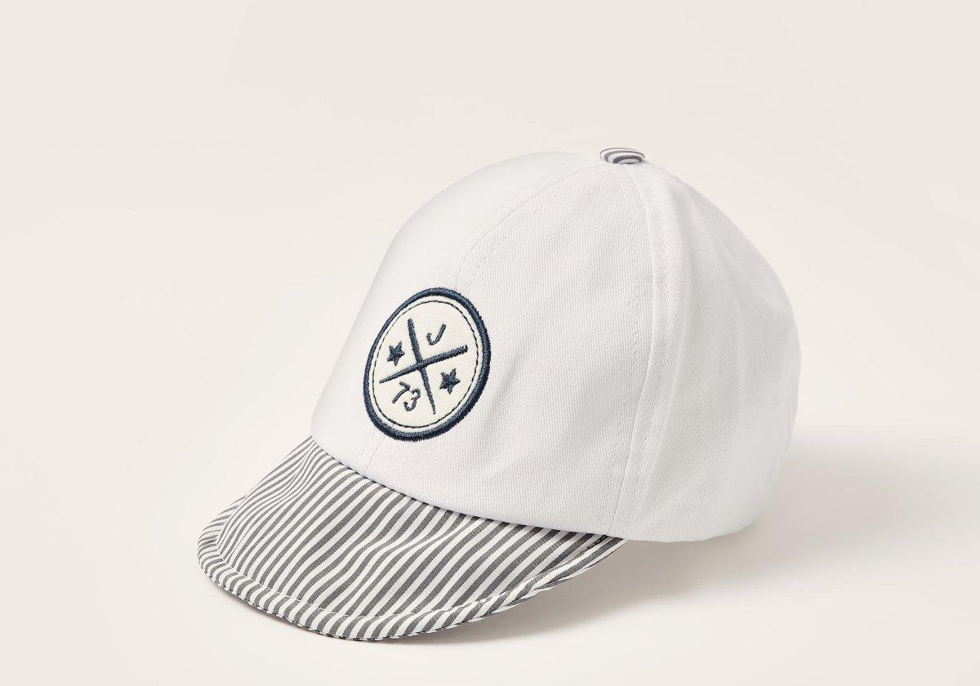
Five picture collage
EMBROIDERY

Slide 14
WHAT THEY SAY ABOUT US

Slide 15
Testimony video
“
My name is Rushan Mohi. I'm the Assistant Event Manager for Klang Advertising Ltd and I'd just like to say thank you to Ahmed from PNG Embroidery for the fantastic independence shares that you did for us. Sublimated, under record 4 hours. That, is fantastic
“
15

Slide 16
Testimony
video
“
I'm from the Department of Lands and Physical Planning. I would like to say a big thank you to Ahmed from the PNG Embroidery for providing us all our merchandises, caps, bags everything and for doing a fantastic job in providing everything within a month and we look forward to continuing working with you guys and we'll definitely come for more supplies, thank you.
“
16

Slide 17
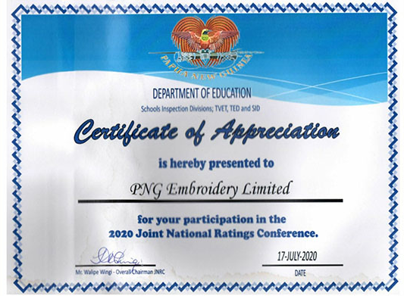
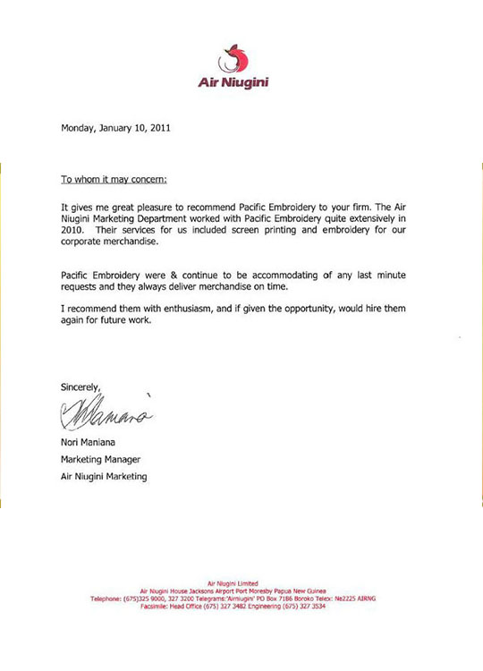
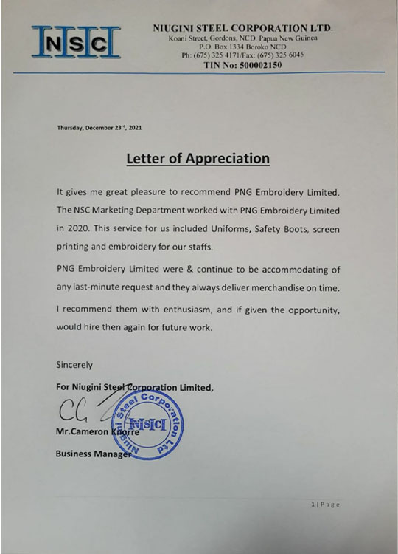
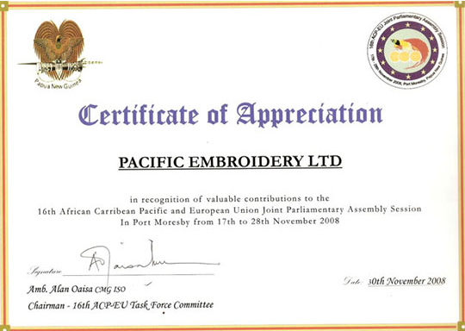
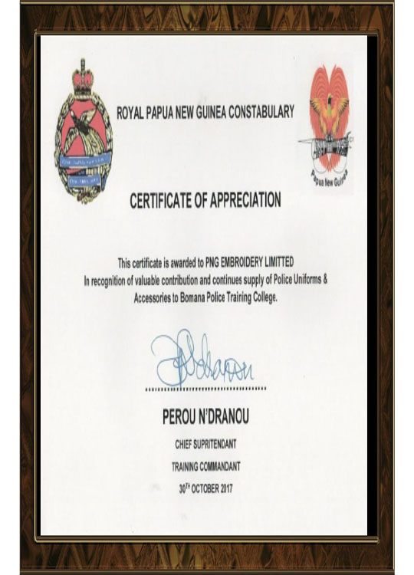
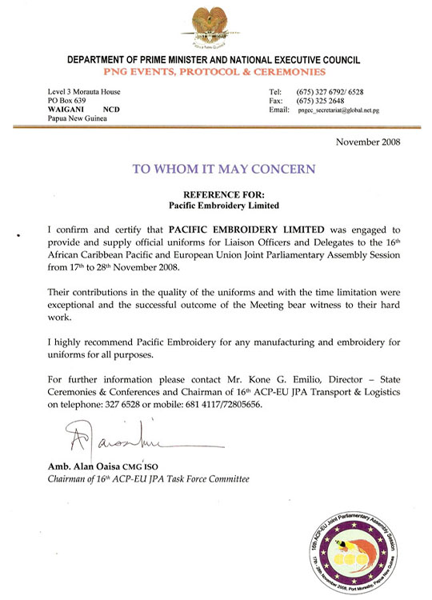
Our certificates
17

Slide 18
THANK YOU
Visit our website: pngembroidery.net
Shop our safety equipment: pngembroidery.net/our-products/
WhatsApp: +675 7311 3600

